Slide 1


Proposal for a CV32E20 “Tiny-FPU”
Joe Circello,
NXP Semiconductors
December 13, 2021

Slide 2
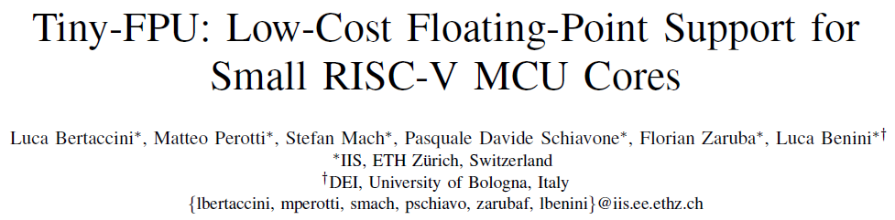
CV32E20F
Concept of optional Floating-Point Unit as follow-on to E20
Driven by compute-intensive applications moving to “edge”
Requires a “size-appropriate” FPU implementation
Integer CV32E20 synthesis target for minimal configuration is ~20 Kgates
Estimated size target for “Tiny32” extension is ~10 Kgates
Supports the Zfinx extension to share a single regfile for both int and FP data
Limited to single-precision support; Tiny-FPU !=, << FPnew
Supports the RISC-V RV32F ISA extensions except for FDIV.S + FSQRT.S
FDIV.S + FSQRT.S performed via integer emulation to minimize gate count
Concept from original May 2021 ISCAS paper by ETH-Zurich

Slide 3
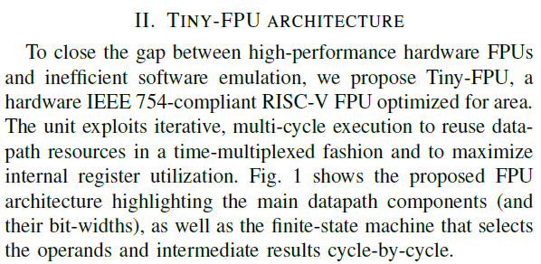
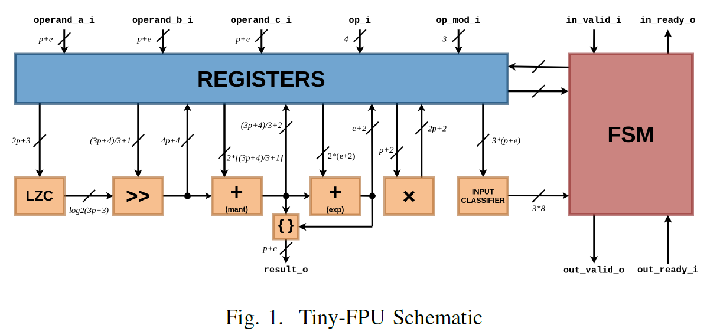
Tiny32 Details
https://ieeexplore.ieee.org/abstract/document/9401149
Tiny32 Execution Time Latency [cycles]
fadd | 10-13
fsub | 10-13
fmul | 18
fmadd | 21-24
fcvt | 9
f{eq,le,lt} | 2

Slide 4
Thank you!

